Slide 1
python
Countdown timer

Slide 2
Count down timer
Do you mean you want:
                .A simple text countdown (like 10 → 9 → 8 …)
A Python/JavaScript countdown timer code?
                Or a visual/HTML countdown clock for a website?

Slide 3
A countdown timer is used to measure how much time is left until an event happens.
It counts backward from a set time to zero.
Where it is used | Purpose
Exams / Tests | To show remaining time
Sports | To count time remaining in a match
Cooking | To notify when food is ready
Online sales | Offers end after countdown reaches zero
Traffic lights | Shows how many seconds left to change signal
Space launch | Countdown before rocket launch

Slide 4
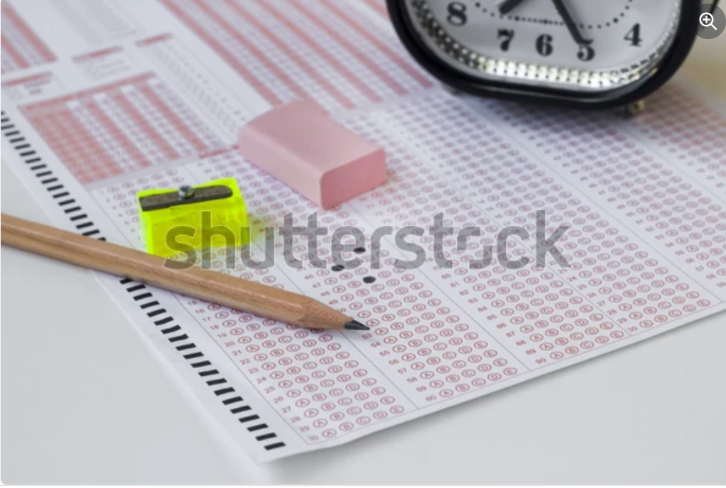
A clock is ticking beside the test paper, showing the urgency of finishing on time.

Slide 5
start
Read input Time_sec
(Example:5se)c
Is time_sec>0?
NO
mins,sec=divmod(
time_sec,60)
yes
Wait 1sec
Time.sleep(1)
Print time format
(show remaining time)
Format time as MM:SS
Timeformat=‘{:02d}:{:02d}’
Time_sec=time_sec-1
Print ”stop”
End
GO back to
“Is time _sec>0 ?”

Slide 6
countdown
Import numpy as np
def countdown(time_sec):
while time_sec:
mins,secs=divmod(time_sec,60)
timeformat='{:02d}:{:02d}'.format(mins,secs)
print(timeformat,end='\r')
time.sleep(1)
time_sec-=1
print("stop")
countdown(5)"""

Slide 7
Conclusion
In conclusion, a countdown timer is a helpful tool that measures the
time left for an event by counting backward. It improves time
management, avoids delays, and alerts us when the time is up. It
plays an important role in education, sports, cooking, technology,
and daily life.

Slide 8
Future Scope
In future, countdown timers can include:
Voice alerts
Mobile app integration
Smart notifications
Automatic scheduling

